Slide 1



Revenue Insights
AtliQ
Hospitality Domain

Slide 2

CONTENT
01
ACKNOWLEDGEMENT
02
ABOUT US
03
CHALLENGES
04
DASHBOARD
05
SUBDASHBOARD
06
STRATEGY
07
NEXT PROJECT

Slide 3
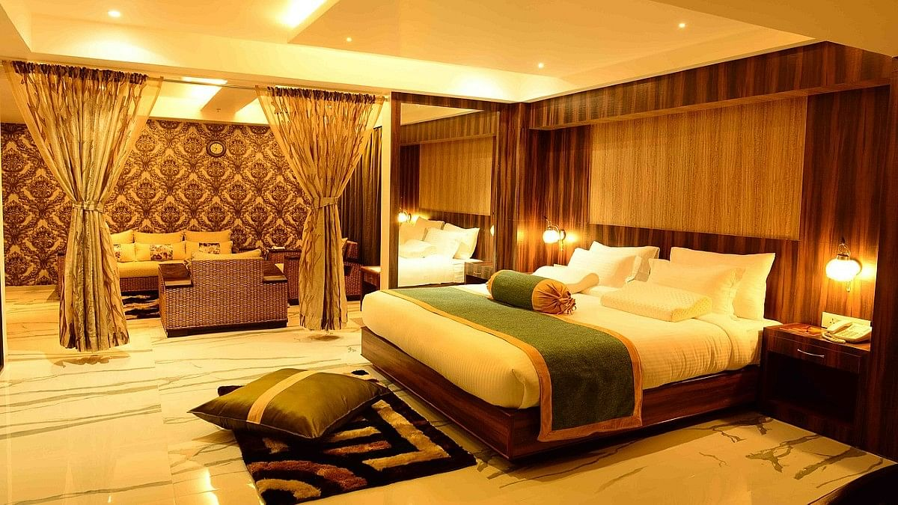



ABOUT US
AltiQ is a company which comprises business and luxury hotels in Delhi, Hyderabad, Bangalore and Mumbai.
It provide customers with hotel rooms through different business platforms.

Slide 4





CHALLENGES
Objective n° 1
Objective n° 2
Objective n° 3
Difficulty in deciding price strategy and different price in different platforms.
Less ratings for some hotels.
Increase daily sellable rooms.

Slide 5

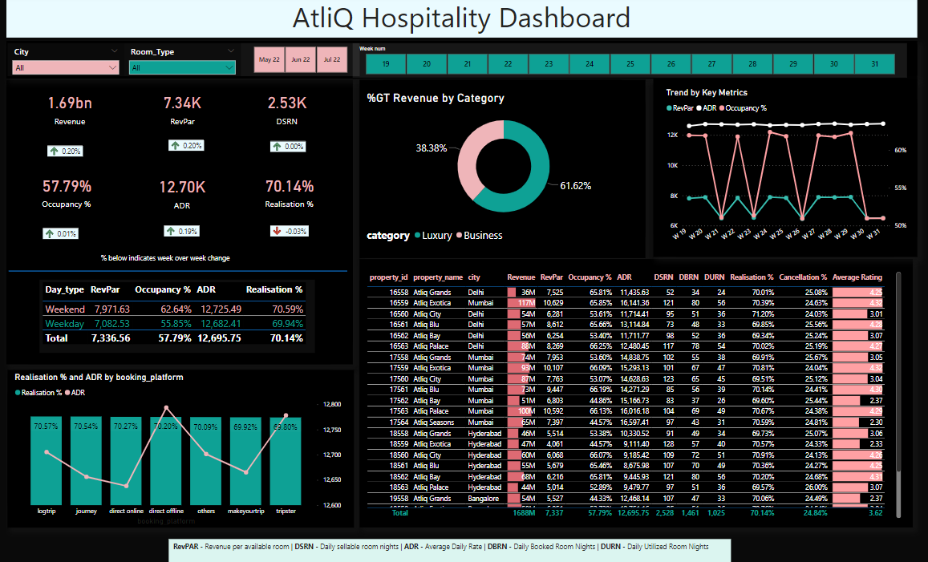
DASHBOARD

Slide 6
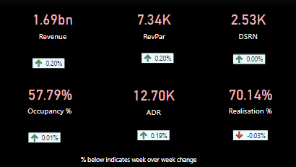
SUBDASHBOARD
Kpi’s are showing the overall values for all the 4 cities i.e., Delhi, Hyderabad, Bangalore and Mumbai in which AtliQ is operating.a
RevPAR stands for revenue per available rooms.
DSRN stands for Daily sellable room nights.
ADR refers to Average Daily Rate

Slide 7
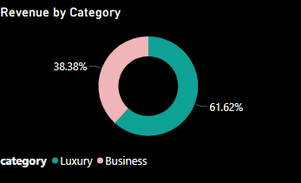
SUBDASHBOARD
AtliQ have 2 categories of hotels:-
Luxury hotels
Business Hotels

Slide 8

SUBDASHBOARD
AtliQ have fixed pricing strategy as the RevPAR and ADR during weekends(Friday and Saturday) is almost equal to weekdays(Sunday to Thursday) pricing.

Slide 9
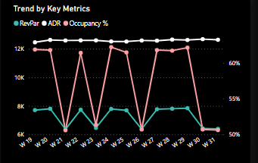
SUBDASHBOARD
RevPAR is fluctuating because Occupancy% is changing. Flat line of ADR indicates there is fixed pricing strategy throughout AtliQ.

Slide 10
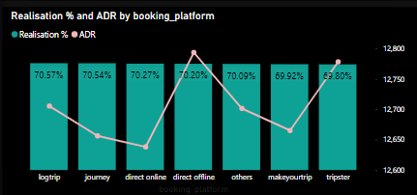
SUBDASHBOARD
AtliQ have different booking platforms like logtrip, journey, direct online (through own website), direct offline, makeyourtrip, tripster and others. The viz indicates that pricing is different in different booking platforms . ADR is maximum in the case of direct offline.

Slide 11
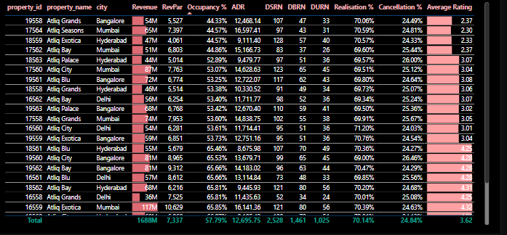
SUBDASHBOARD
AtliQ Grands In Bangalore which is a luxury hotel has least occupancy rate and the average rating is 2.37.

Slide 12
KEY INSIGHTS
01
Revenue by City – Mumbai(660.6M), Bangalore(415.0M), Hyderabad(321.2M) and Delhi(290.9M).
02
Occupancy % by City- Delhi(60.4%), Hyderabad(58.0%), Mumbai(57.8%) and Bangalore(55.7%).
03
Average Rating by City – Delhi(3.8), Hyderabad(3.7), Mumbai(3.7) and Bangalore(3.4).
04
Overall Occupancy% =57.8% , Average Rating =3.62
05
Booking % By Room Class – Elite(37), Standard(29), Premium(23) and Presidential(12).

Slide 13




STRATEGIES
Pricing is different in different platforms which can be improved by providing promotions through coupons and discounts.
AtliQ can have priced luxury hotels with weekday and weekend pricing as there is no major difference on pricing in weekends and weekdays.
Atliq can pick bottom 20% hotels based on their ratings, occupancy % etc. and try to solve their issues so that 80% of the business improves.
STRATEGY N°1
STRATEGY N°2
STRATEGY N°3

Slide 14

THANK'S FOR WATCHING

